Slide 1
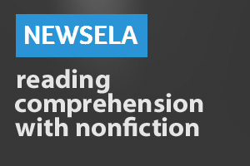
How to
For Honors
For Honors

Slide 2
Step 1
Close Read the article.
Close Reading Steps:
Number paragraphs
Read and circle unfamiliar words.
Find the definitions.
Re-read and underline main idea/point in each paragraph.
Answer questions in complete sentences, restating the question.
Highlight answer in text if appropriate.

Slide 3
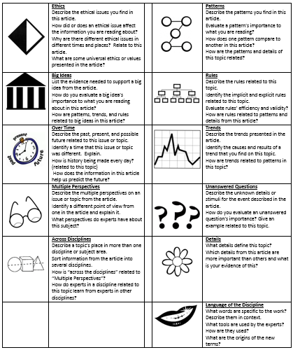
Step 2
Decide which GATE Icon with which you wish to examine the content

Slide 4
Step 3
Create a Question
Your question must:
Be thorough
Be intellectually creative
Align with a GATE Icon
Require understanding of ideas beyond surface information provided in article
NOTE: The article is really a jumping off point or inspiration for your outside research. Create a question that you are interested in so that you get the most out of the assignment. If this is boring, that’s your own fault. :)

Slide 5
Step 4
Research your topic
Your research should:
Directly and thoroughly address your topic
Be comprised of appropriate academic sources
Be cited appropriately

Slide 6
Step 5
Answer your question
Your answer must:
Summarize your research (no more than 200 words… yes, you must edit!)
Be in your own words
Cite your sources
Incorporate much information beyond the article
Be comprehensive and accurate
Be organized to aid the reader’s better understanding of your analysis
Be mechanically perfect and utilize high academic language effectively

