Slide 1
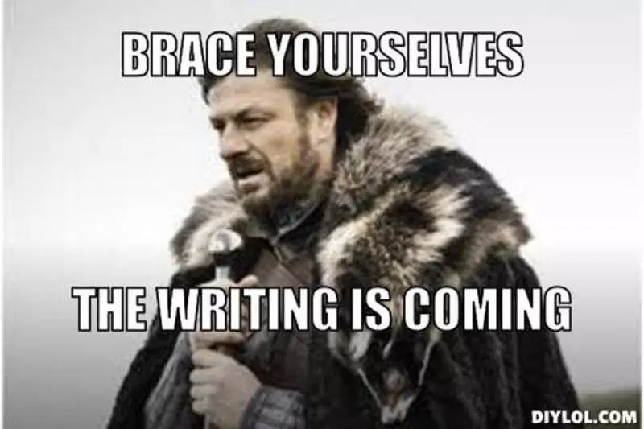
DBQ Paragraph Writing Tips

Slide 2
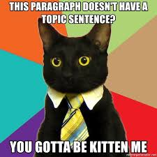
Topic Sentence
If writing a paragraph: this should NOT include your reasons.
If you put your reasons in this sentence, the paragraph is redundant.
This is not the case when writing a full multi- paragraph essay. For that task, you DO write a full thesis statement with a “roadmap”.

Slide 3
What NOT to do...
“The British officials and the colonists had differing views regarding the Stamp Act protests because the British officials saw them as the actions of a few angry people while the colonists viewed them as an expression of widespread popular opinion.”

Slide 4
What to do...
“The British officials and the colonists had differing views regarding the Stamp Act protests.”

Slide 5
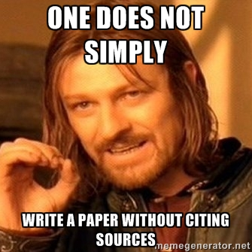
Evidence
All evidence must be quotation from the documents.
You must properly attribute each quotation within the text.

Slide 6
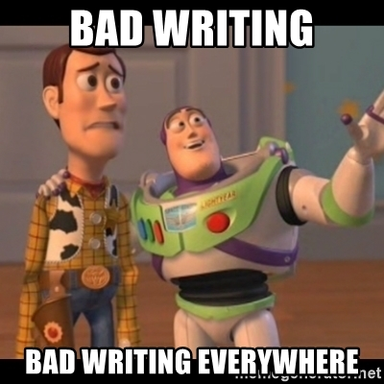
What NOT to do...
“In the document, it said that the British thought that the colonists were out of line.”
“In Document B it states…”

Slide 7
What to do...
According to a diary entry written by John Adams on December 18, 1765, he states “...”

Slide 8
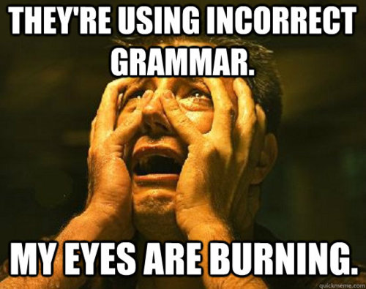
Writing Conventions
CAPITALIZATION!!!
All proper nouns
Britain, American, Boston, names, places
No contractions
Can’t, Won’t…
No first person
“I think…”
No two sentences begin with the same word
use transition words

Slide 9
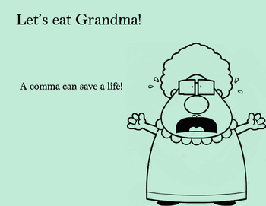
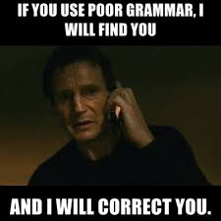
Because I LOVE grammar memes...

Slide 10
One last thing...

Slide 11
One more last thing...

